Slide 1
Manga and Anime: An analytical study
コスプレ
Jordan Allen-Brandon, Ariana Dunlap, Rachel Miller

Slide 2

What is Manga and Anime?
Manga: A style of Japanese comic books and graphic novels
Anime: a style of Japanese film and television
The style became notably popular in the 1960s and has remained steadily
Popular in the United States
コスプレ
Notes:
Manga and anime are both Japanese artistic styles. Mnaga being in a graphic novel and anime being a Japanese style of animation. Modern manga began to be developed in the 1940s through til the 50s through US occupation in Japan. From the 1960s on in the US, Manga and anime have remained steadily popular, by 2007, the anime market in the US alone amassed a value of over 4 billion dollars. (Kimberly)

Slide 3
Why did we choose this Data set?
コスプレ

Slide 4
Popularity and Prevalence
Popularity
Prevelance
コスプレ
Huge market in entertainment
Provides interesting insight into growing sub cultural significance amongst Americans
Growing popularity is showing lasting significance within American culture
… And it’s just fun to study!
Notes:
The popularity of Manga and Anime is hard to miss nowadays. Anime is on mainstream cartoon networks on cable and has been for years. The objective of this data analysis was to dive deeper into popularity of shows and series. It is a prevalent in main stream culture and provides fun insight into what people are tuning into or reading. A light hearted study about pop culture!

Slide 5
TABLE OF CONTENTS
01
03
02
04
コスプレ
Data Cleaning
Anime Adaptations
Challenges that arise with understanding a dataset
Are anime adaptations well received?
Volumes vs Popularity
Longevity
Does the amount of volumes influence popularity of a manga?
Are people more likely to tune in for awhile or lose interest?
Notes:
Here is just an overview of the flow of the presentation. We will start with data cleaning and dive into our questions we have for the data set. Those questions having to do with volumes of manga book in a series playing a role in popularity. Anime adaptations being well received, and determining if people love the feeling of nostalgia or are looking for fresh plot lines. So lets dive right in.

Slide 6
01
Data Cleaning
コスプレ
Understanding the dataset

Slide 7



Data Cleaning
Data Source:
https://www.kaggle.com/datasets/nikhil1e9/myanimelist-anime-and-manga
Cleaning up useless columns and rows
Merging data sets
Understanding notation
コスプレ
Notes:
We found the data source on Kaggle, There were over 13,000 rows for each data set which we thought was plenty big enough to run some analysis.
Some of the columns that we did not use were the page_url and the image_url columns. Additionally, we replaced rows with question marks to either not include them or add a value of unknown.
In the merging of the data, there had to be some exclusions of certain rows as there were repeats.
Understanding the columns/notation of the dataset was also important to the analysis. the Score was the average rating of the show given by users of a website which is the backbone of the proceeding data analysis

Slide 8
02
Volume vs Popularity
コスプレ
Is the amount of volumes of a manga series significant to the popularity of that series?
Notes:
jordan

Slide 9
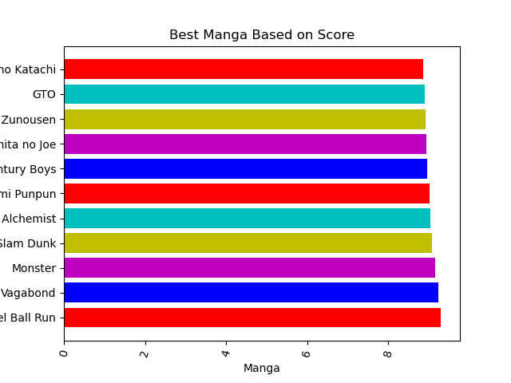
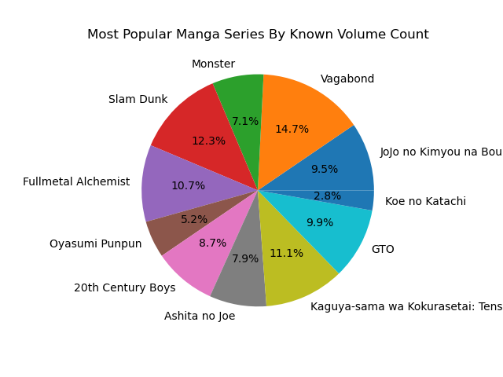

Volume vs Popularity
Possible visual positive relationship
Most popular title:
Steel Ball Run
コスプレ
Notes:
jordan

Slide 10
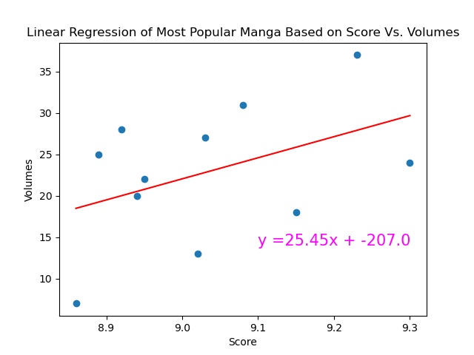
Volume vs Popularity cont…
P-value = 0.18
R-squared = 0.19
コスプレ
Notes:
jordan

Slide 11
03
Anime Adaptations
コスプレ
Are Anime adaptations of Manga well-received by viewers?
Notes:
rachel

Slide 12
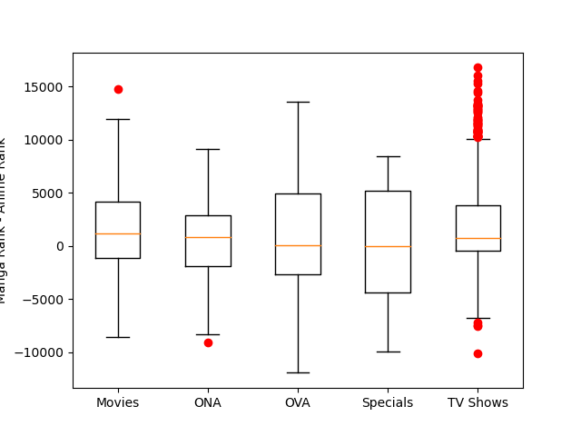
Anime Adaptations Comparative Rank Distribution
Manga Rank – Anime Rank
コスプレ
Notes:
rachel

Slide 13
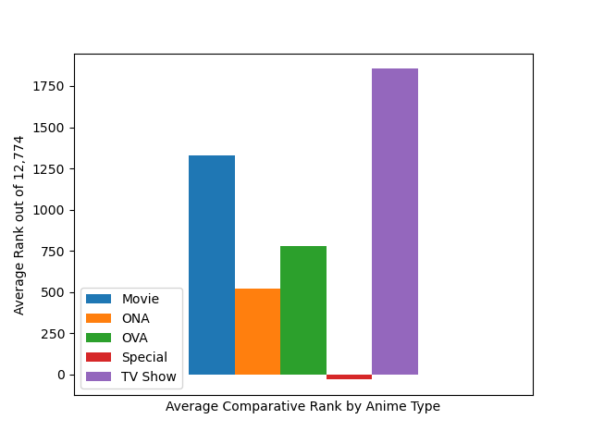
Average Comparative Anime Ranks
コスプレ
Notes:
rachel

Slide 14
04
Old vs New
コスプレ
Is popularity greater for shows that have been completed?
Notes:
ariana

Slide 15
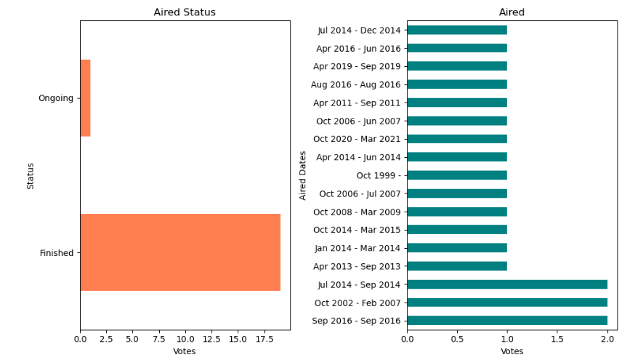

Old vs New
Favored completed anime’s
Most popular air dates were 2014-2016
コスプレ
Notes:
ariana

Slide 16
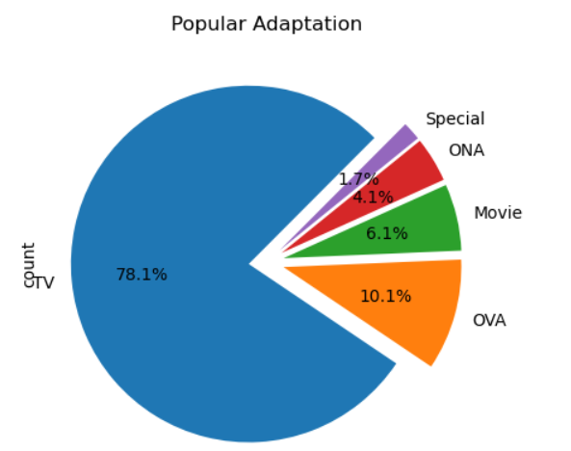
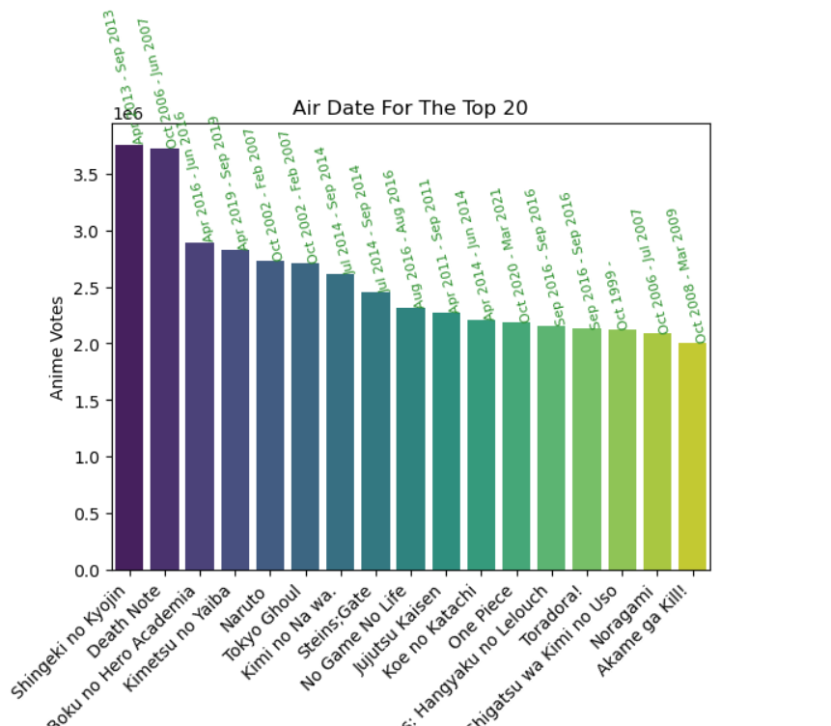
Old vs New cont.
TV adaptations are more favorable by 78%
Notes:
ariana

Slide 17
05
Limitations
コスプレ
Where could we expand? Where did we fall short?
Notes:
Kim/Jordan/ariana

Slide 18



Limitations
Bias in score
Data is limited
Data set is relatively simple
コスプレ
Notes:
Bias in score: Score is based off of a anime and manga website posted by members of the website. This skews the score data as the people participated already enjoy manga and anime.
Data is limited in that there could have been more columns to give even deeper insights. A column that could’ve allowed for deeper insight could’ve been a genre column and a subgenre column.
Pigging off the last comment, the dataset is simple, thus simple insights can be made. This limits the depth of knowledge that could be gained from learning more about anime and manga.

Slide 19
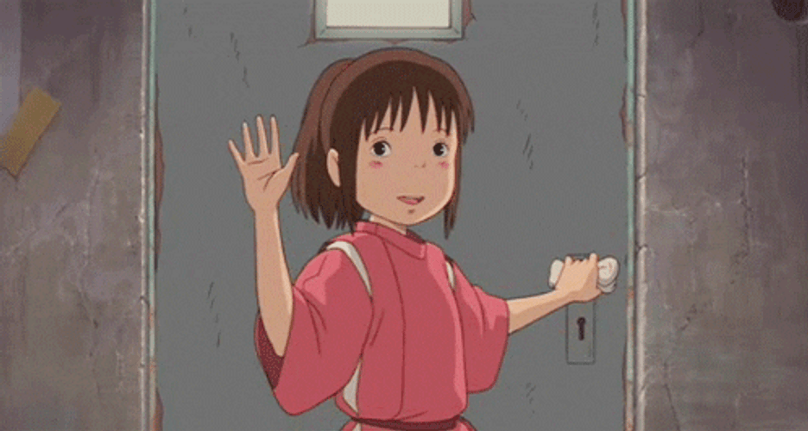
THANKS!
コスプレ
Questions?
Notes:
All together

Slide 20
RESOURCES
コスプレ
https://www.infoplease.com/culture-entertainment/tv-radio/manga-and-anime-japanese-invasion#:~:text=Indeed%2C%20the%20term%20manga%20dates,peaked%20at%20a%20value%20of
https://en.wikipedia.org/wiki/Manga
https://www.merriam-webster.com/dictionary/anime
Notes:
No one

